Slide 1
Sport NZ Group Organisational Health & Capability Report
For the three months to 31 December 2018

Slide 2

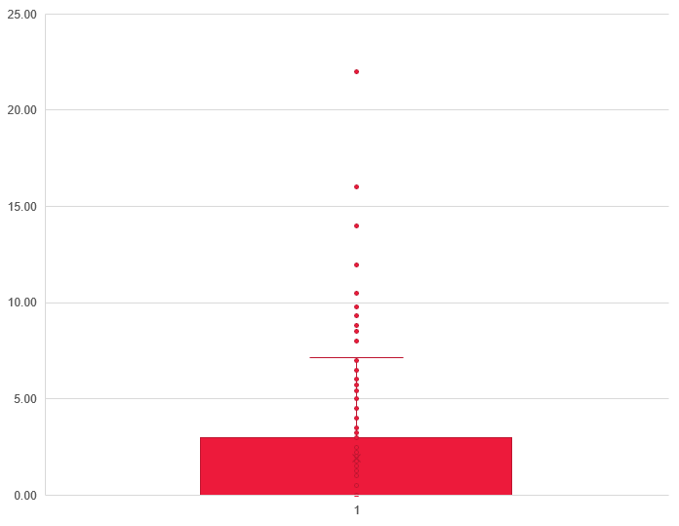
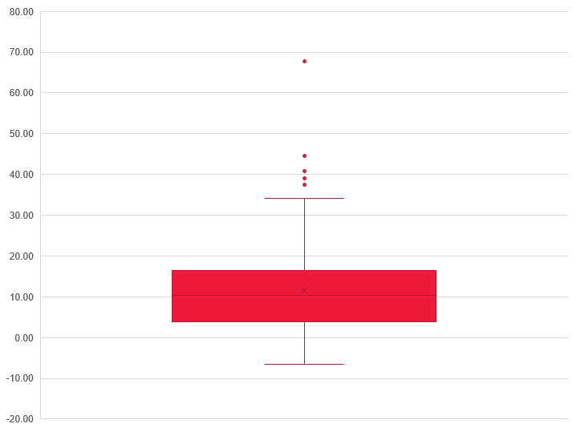
Good Employer Indicators
Annual staff turnover
Annual Leave balance
Sick leave
Status | Commentary
 | Staff turnover was relatively high due to structural change. Turnover is expected to drop over time. The target is 12% or less.
Status | Commentary
 | Average – 11.47%. On average, 84% of staff have an annual leave balance of less than 20 days. The graph indicates at least 16% of staff have a leave balance greater than 20 days with three staff members with over 40 days of accrued annual leave. There are arrangements in place, such as annual leave plans, to enable staff to take annual leave.
Status | Commentary
 | Average – 1.79% 88 Staff have taken 2 or more sick leave days over the past 12 months. The graph indicates that two staff have taken more than 20 days’ sick leave.

Slide 3
Employee Demographics
Gender
Age Band
Working Arrangements

Slide 4
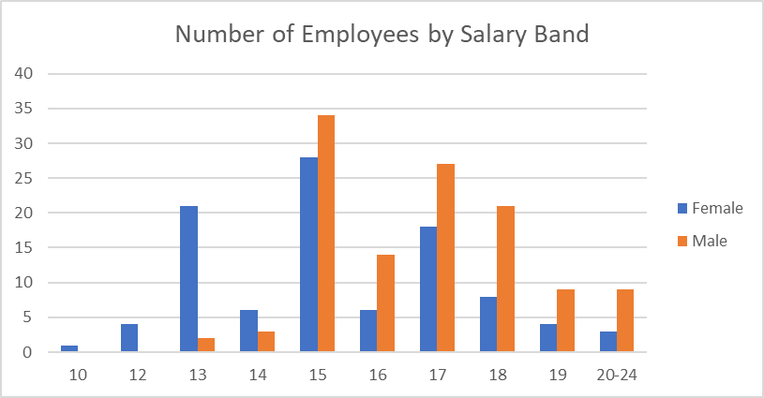
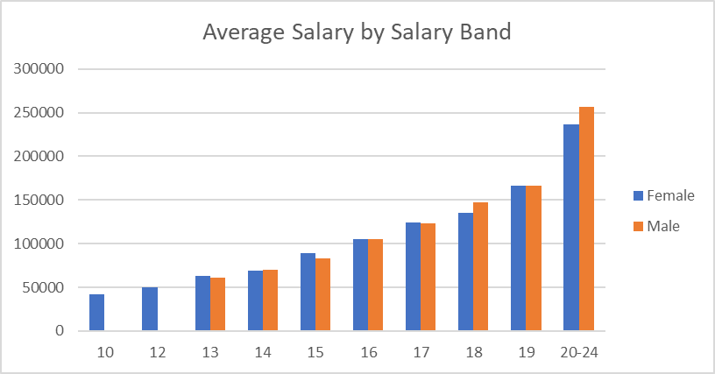
Employee Demographics continued
Ethnicity
Front vs. Back Office
Pay & Position Parity

Slide 5
Official Information Act Requests
Requests under the Official Information Act 1982 for the three months ended 31 December 2018
On hand* | Requests received | Responded to in 20 working days | Responded to after 20 working days | Average time to respond (working days) | Transferred | Declined
1 | 6 | 4 | 1 | 19.6 | - | -
*‘On hand’ refers to OIA requests received and underway at the Quarter commencement date.

