Slide 1
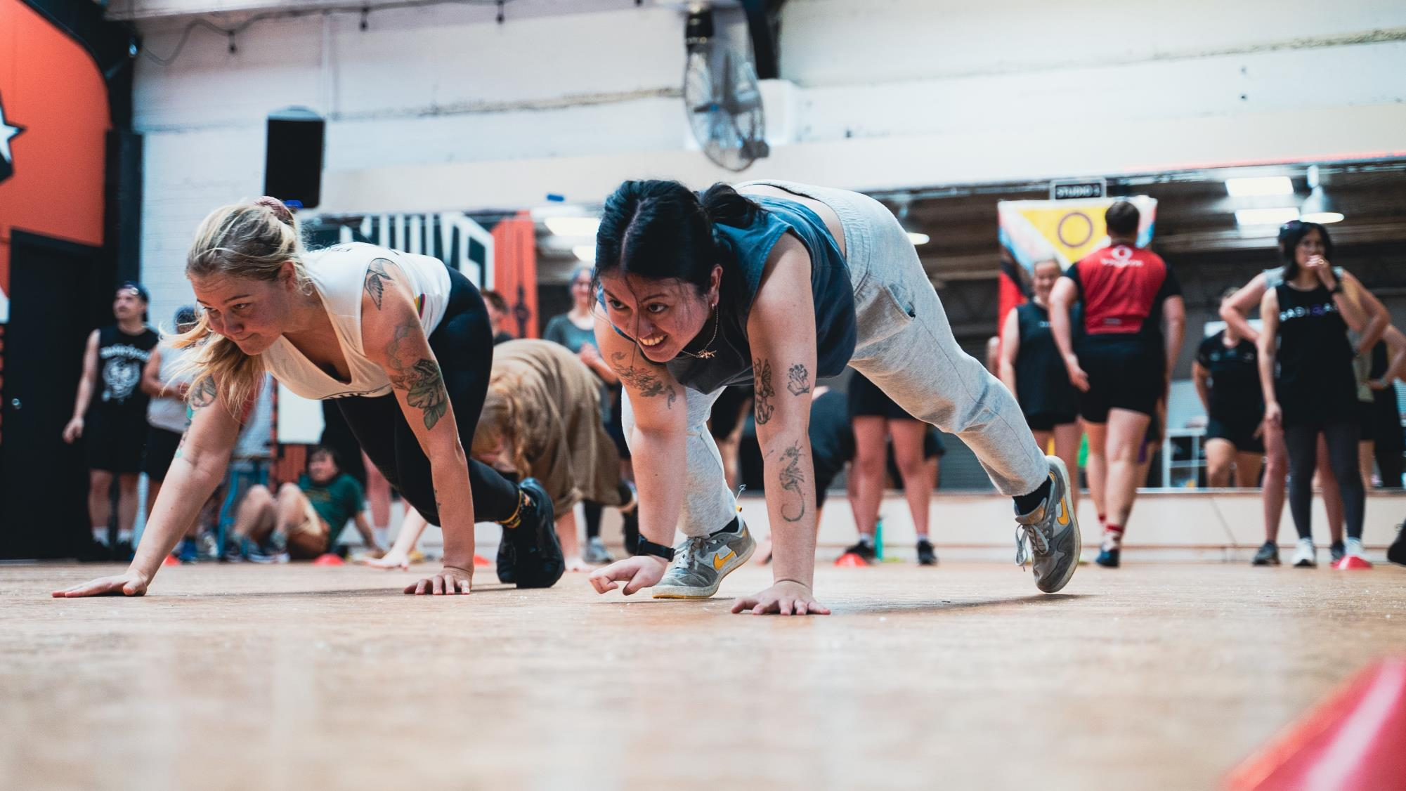


Peer crowds and physical activity
Who hangs out with who and why?
Active recreation for rangatahi

Slide 2
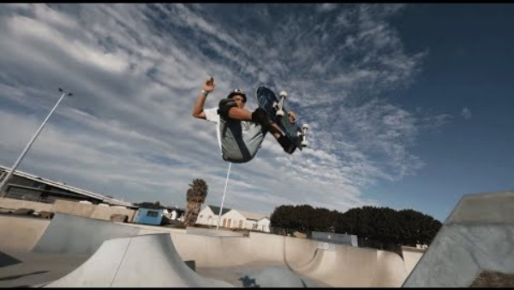

Active recreation for rangatahi
© Sport New Zealand
Notes:
Active recreation is physical activity for fun and wellbeing – it’s not about competition.
The video highlights the diversity of active recreation – both through the activities featured and groups of rangatahi.
Every young person is different and so are the ways they want to move and why.
Active recreation gives rangatahi the freedom to be active in ways that are right for them.

Slide 3
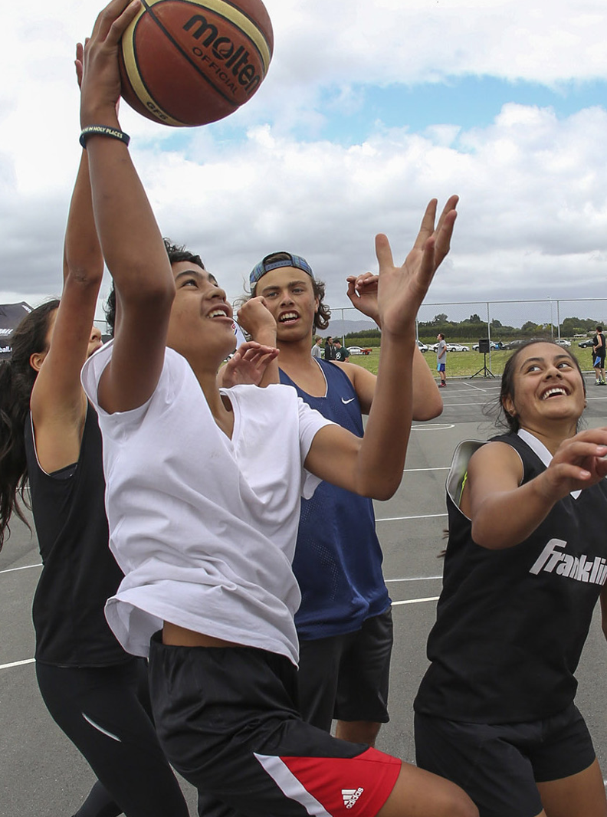
Active recreation for rangatahi
Our focus
Maintain and grow the physical activity levels of rangatahi.
Support the wellbeing and development of rangatahi.
Provide quality opportunities and experiences that meet the needs, wants and aspirations of rangatahi.
© Sport New Zealand
Notes:
Many rangatahi become less active during their teenage years.
Our focus is on creating more and better opportunities and experiences, especially for those who are less active.
We believe active recreation can play a vital role in supporting the wellbeing and development of rangatahi across Aotearoa.

Slide 4

Active recreation for rangatahi
Understanding active recreation
Active recreation is physical activity for fun and wellbeing – it’s not about competition
It can be challenging to understand active recreation because:
it’s broad and diverse
it’s not just one sector, it’s many
we don’t talk about doing “active recreation”
it can sometimes be mistaken for organised sport.
© Sport New Zealand
Notes:
Broad and diverse – it can mean different things to different people
Not just one sector e.g. outdoor sector, exercise and fitness
We might say we are going to a dance class or the gym rather than saying we’re doing “active recreation”
It can sometimes be mistaken for organised sport, e.g. someone might go out for a surf to relax and feel good, which is active recreation whereas if they surf for social or competition then that is sport.

Slide 5


Active recreation domains

Slide 6
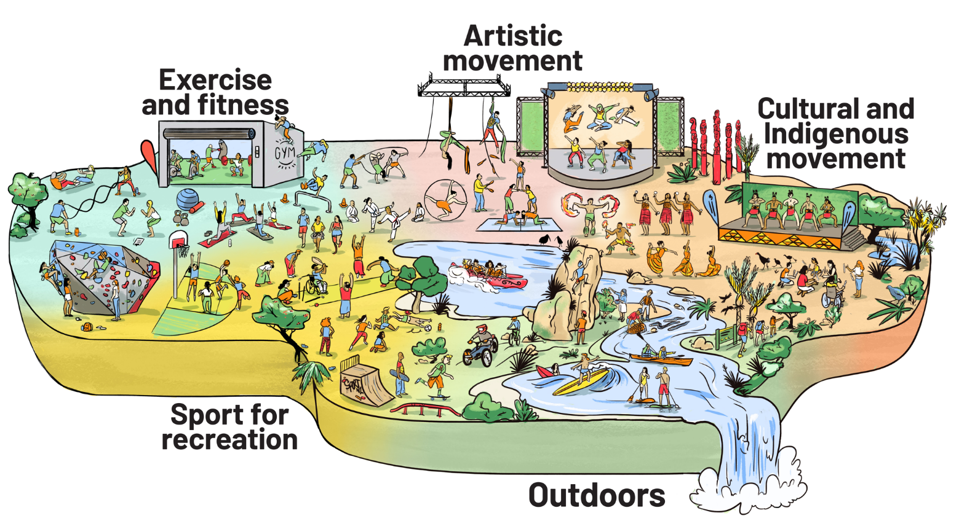
Active recreation for rangatahi
© Sport New Zealand
Notes:
This illustration brings our existing active recreation domains to life.
It has been created to support partners to understand and talk clearly and confidently about active recreation.
It shows how broad and diverse active recreation can be. It’s not just one sector or type of activity – it includes many different areas, which we call domains.
Rangatahi may take part in activities across several domains, and these often connect and overlap.
While we’ve grouped activities into 5 domains to help explain them, rangatahi may see things differently based on their own views and reasons for getting involved.

Slide 7
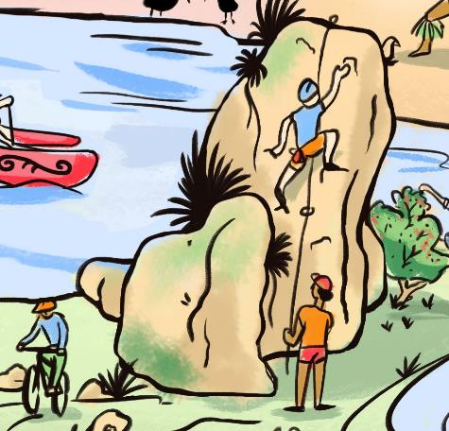
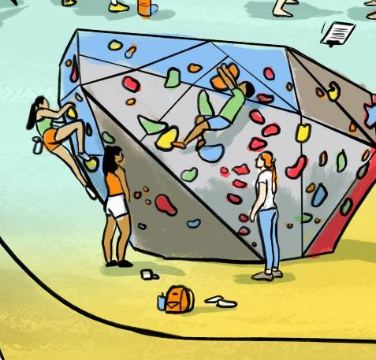
Active recreation for rangatahi
Domains connect and overlap
A young person might enjoy rock climbing as a way to connect with the natural environment, which fits within the ‘Outdoors’ domain.
Another might prefer indoor rock climbing for fitness, aligning with the ‘Exercise and fitness’ domain.
© Sport New Zealand
Notes:
There are many ways rangatahi choose to be active and why.
What they choose will depend on their motivations and aspirations.

Slide 8
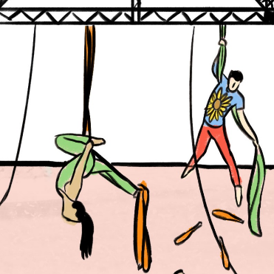
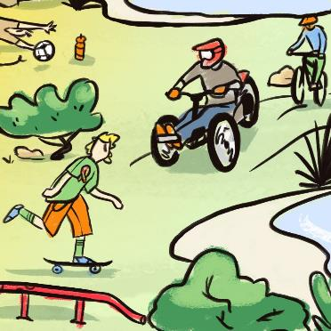
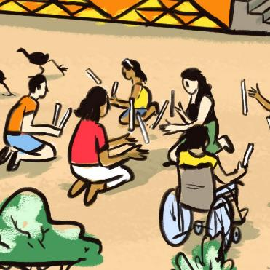
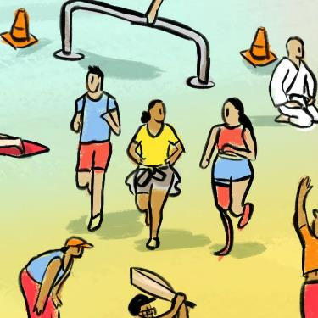
Active recreation for rangatahi
Domains are diverse
The domains are built to be inclusive of different:
physical activities
age groups
genders
ethnicities
abilities – including both physical and non-visible disabilities.
© Sport New Zealand
Notes:
Domains show:
Activities: Circus arts, skateboarding, biking, rākau, running
Physical disabilities: Young person on adaptative bike, in wheelchair and with a running blade
Non-visible disabilities: Young person doing circus arts with sunflower on their top (sunflower is a symbol of individuals with non-visible disabilities), and skateboarder with autism ribbon

Slide 9
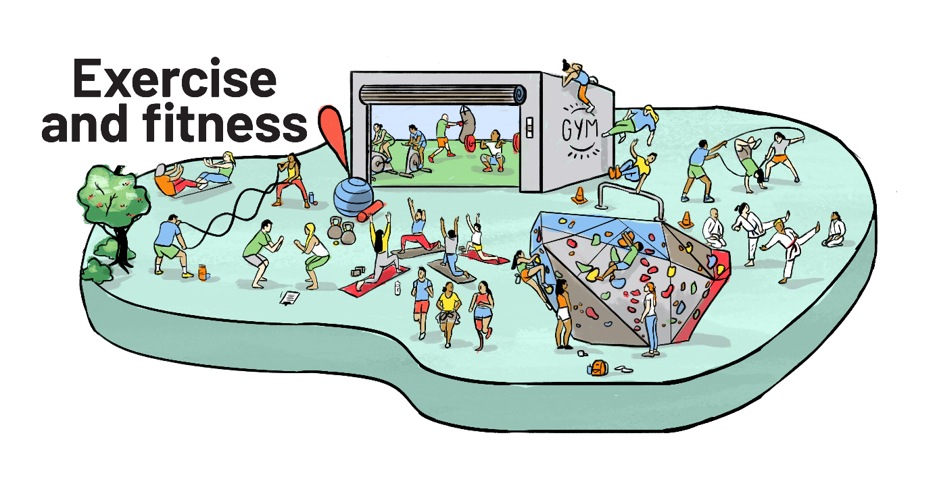
Active recreation for rangatahi
Physical activities that enhance aspects of fitness such as strength, endurance, flexibility and balance through repeated body movements.
© Sport New Zealand
Notes:
Example activities: exercise class, gym workout, boxing, weight lifting, yoga
Examples of overlapping domain activities: running, indoor rock climbing, martial arts, skipping, parkour

Slide 10
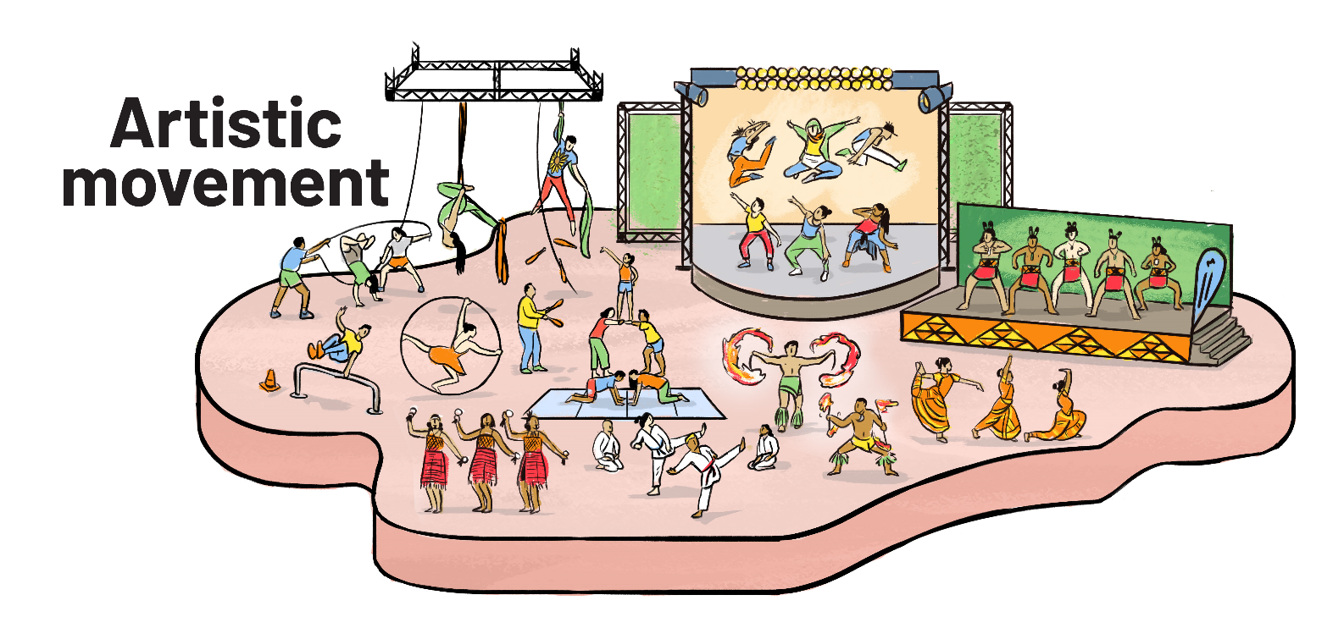
Active recreation for rangatahi
Physical activities that enable creativity and self-expression, often involving music.
© Sport New Zealand
Notes:
Example activities: circus arts, cheerleading, dance
Examples of overlapping domain activities: martial arts, kapa haka, siva afi, kapa haka, bharatanatyam

Slide 11
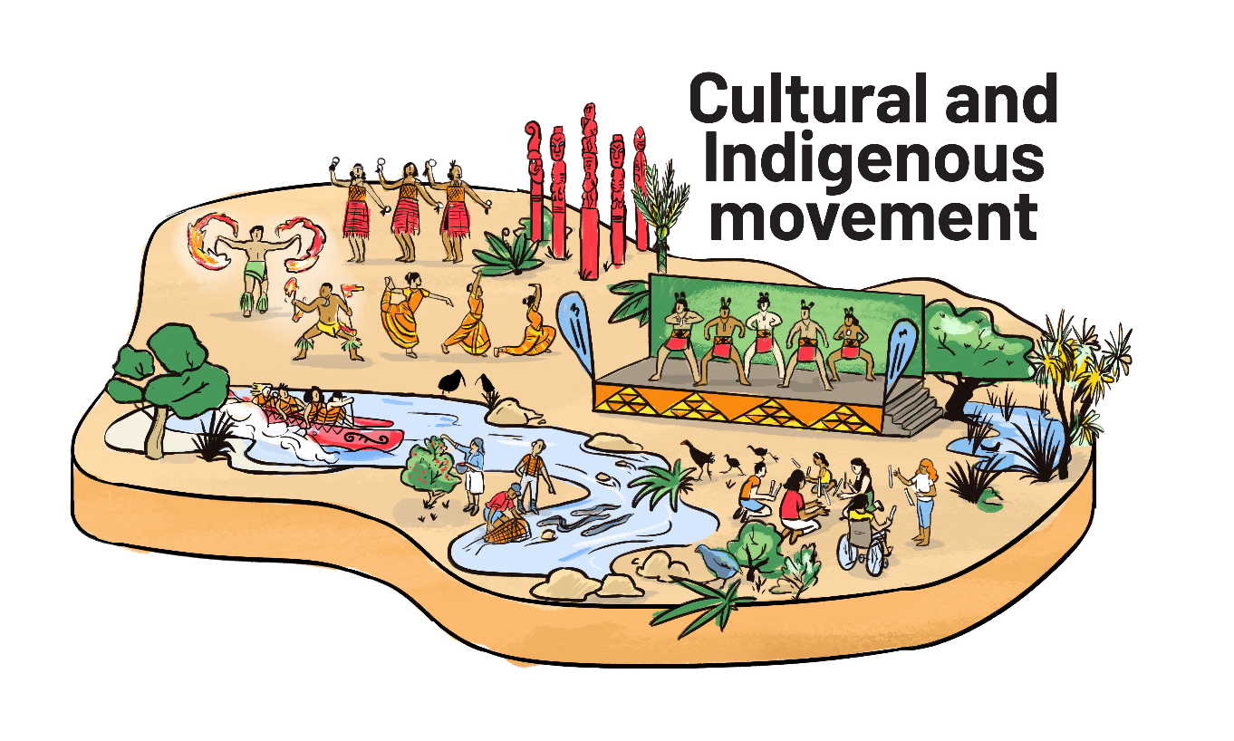
Active recreation for rangatahi
Physical activities that preserve, revitalise, and celebrate cultural heritage and Indigenous traditions.
© Sport New Zealand
Notes:
Example activities: rākau, kai collection, Bharatanatyam
Examples of overlapping activities: kapa haka, siva afi, bharatanayam

Slide 12
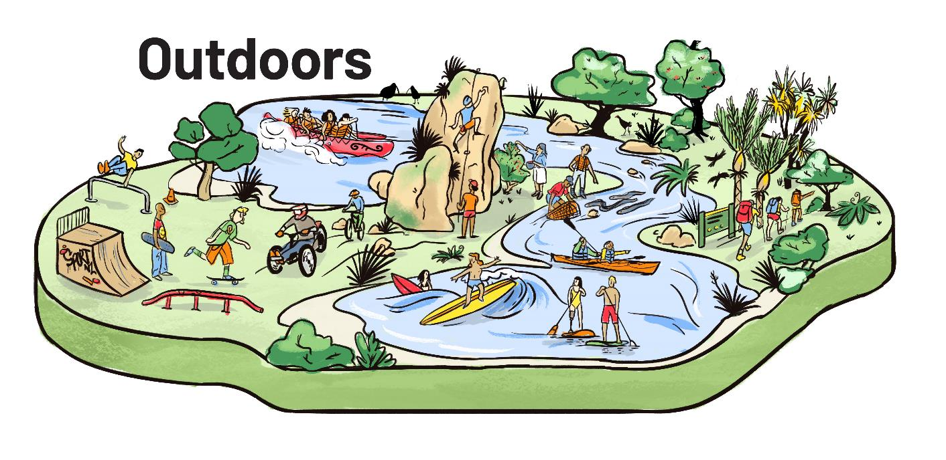
Active recreation for rangatahi
Physical activities that enable experiences in, and connection to, the natural environment.
© Sport New Zealand
Notes:
Example activities: tramping, kayaking, paddle boarding, outdoor rock climbing
Examples of overlapping domain activities: kai collection, surfing, mountain biking, skateboarding, parkour

Slide 13
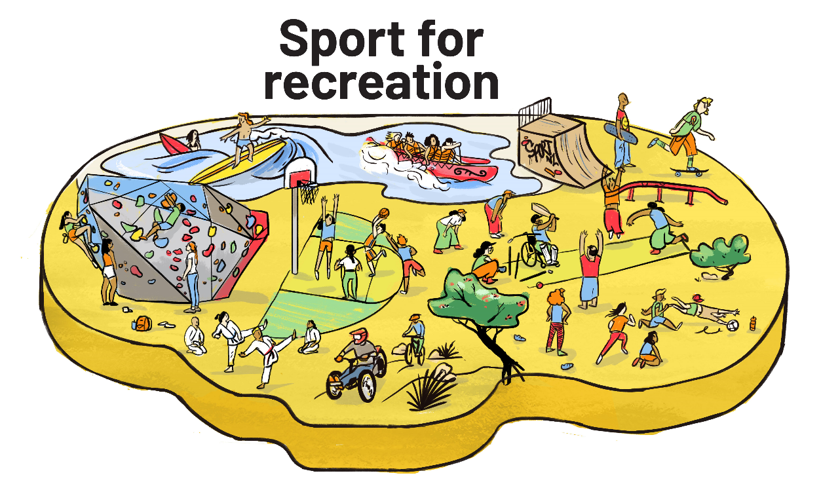
Active recreation for rangatahi
Sporting activities that are flexible, informal and focused on fun and enjoyment. Often doesn’t involve an official team, coach or competition. Depending on rangatahi motivations and aspirations, it can also connect with the Sport Pathways Framework.
© Sport New Zealand
Notes:
Example activities: backyard cricket, shooting hoops, kicking a ball
Examples of overlapping domain activities: martial arts, mountain biking, skateboarding, waka ama, surfing, indoor rock climbing.
Note: The illustration is designed in the same style as the Sport Pathway Framework – intentionally connected, with rangatahi reflected in both. Where a young person is represented depends on their motivations and aspirations. For example, someone might go for a casual surf to relax and feel good – that’s active recreation under the ‘Sport for recreation’ domain. But if they’re more into social or competitive surfing, then the same activity could sit within the Sport Pathway Framework.

Slide 14
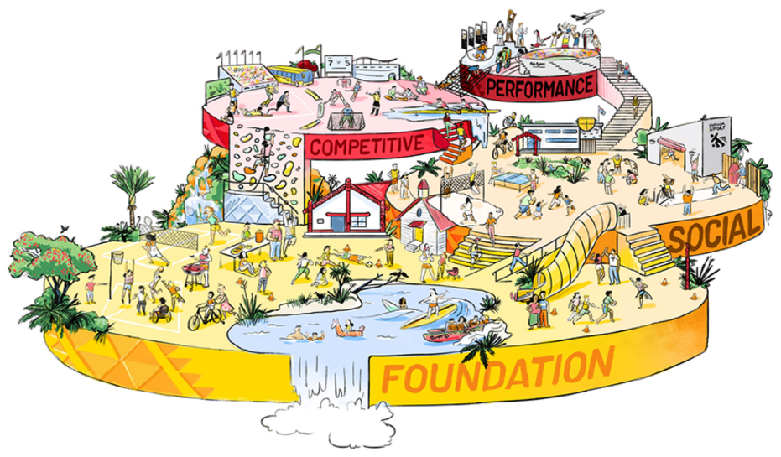

Active recreation for rangatahi
Sport in the Sport Pathways Framework may include an official team, structured formats, coaches and officials.
Sport for recreation often doesn’t involve an official team, coach or competition.
© Sport New Zealand
Notes:
It can be difficult to clearly define when an activity is considered sport for recreation versus foundation, social, or competitive sport. The distinction often depends on rangatahi motivations and aspirations and how they participate.
An activity may resemble the SPF if it, involves an official team, follows a structured format and includes a coach or official.
The enablers that support a quality experience can be different depending on whether it’s an activity aligns more to the SPF, or the Active Recreation domains.
It’s not black and white!

Slide 15
How we can support rangatahi

Slide 16





Active recreation for rangatahi
Advocating for active recreation
Listen to the voices of rangatahi. Involve them meaningfully in planning, design and decision-making.
Support rangatahi to be active in ways that work for them. Provide growth and leadership opportunities.
Create more and better opportunities so that all rangatahi can thrive.
© Sport New Zealand
Notes:
Listen to the wants, needs and aspirations of rangatahi. How can you involve them in the planning, design and decision-making?
Support growth and leadership opportunities in active recreation.
It’s important to recognise the many ways rangatahi choose to be active and why. Create more and better access to a diverse range of physical activities so they can find something that feels right for them.

Slide 17
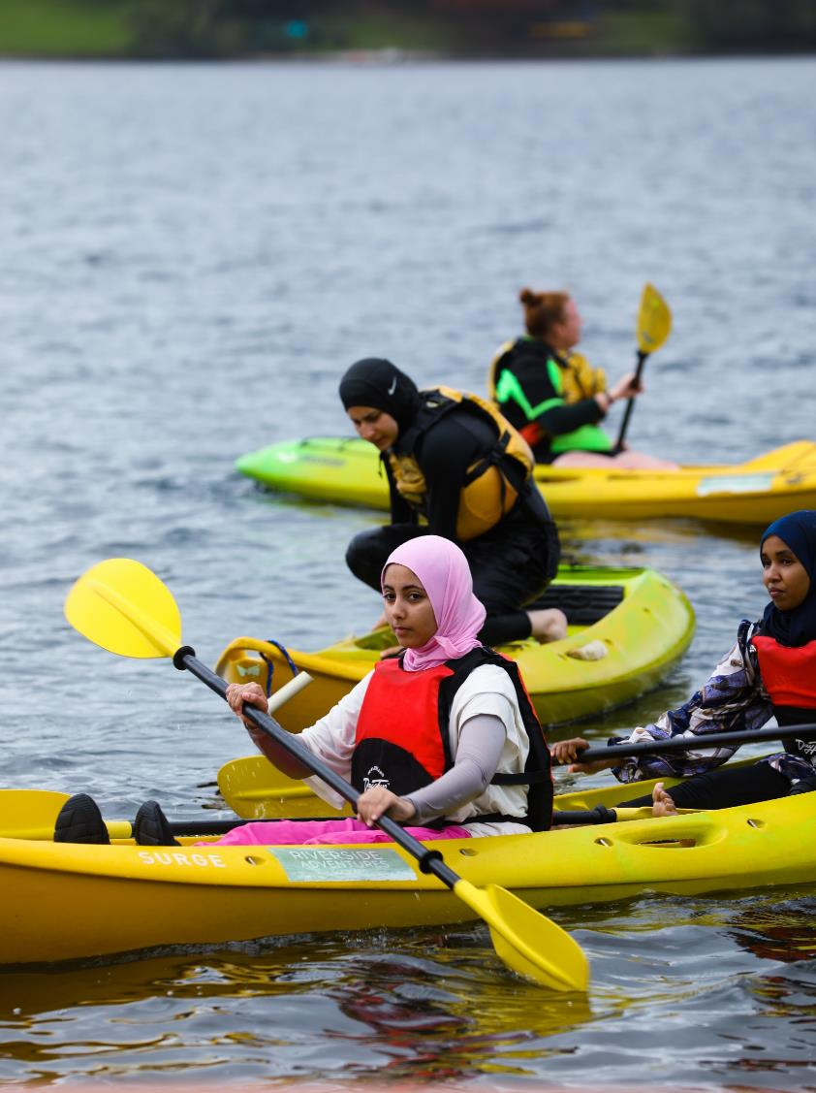
Active recreation for rangatahi
Reflective questions
How are we meeting the diverse needs of different rangatahi groups?
In what ways can we broaden the range of activities we offer, or support, to better reflect the interests of all rangatahi?
How can we strengthen collaboration within and across domains to create more and better opportunities for rangatahi?
© Sport New Zealand
Notes:
Physical activity opportunities and experiences we provide need to align to their wants, needs and aspirations.

Slide 18
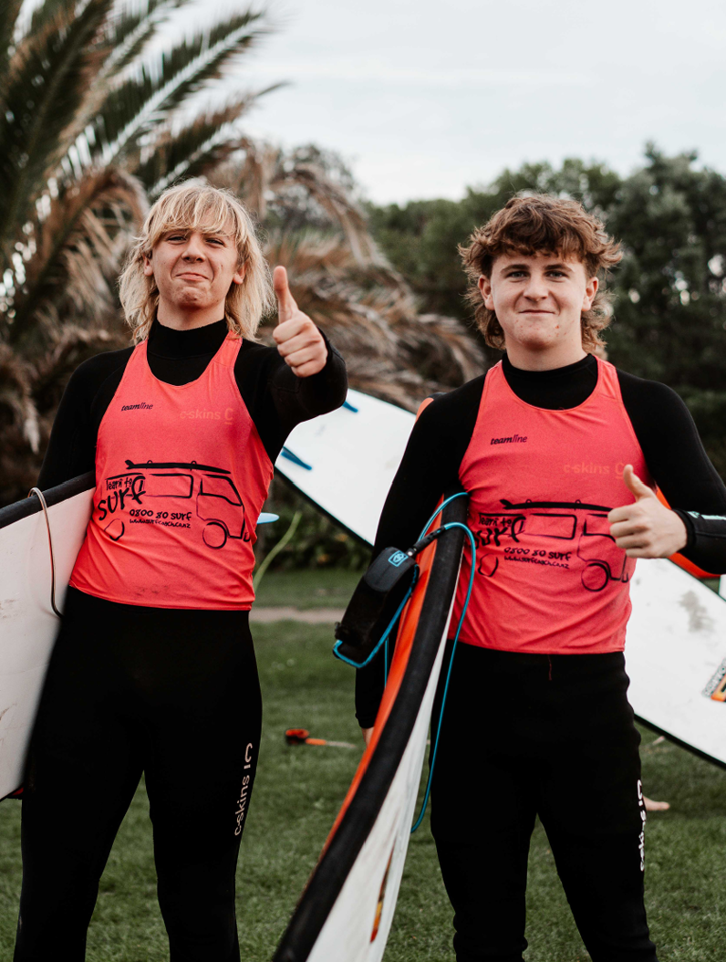
Active recreation for rangatahi
For more information
Active recreation toolkit
https://sportnz.org.nz/active-recreation
Related resources
Rangatahi peer crowds report
Mana Taiohi framework
Youth voices in active recreation and sport
© Sport New Zealand

Slide 19
Ngā mihi

